Slide 1
ZOMBIE: A SEARCH GAME
Matthew Cornetto
Hailey Stormy Cooper
Frances Ramirez
Tsvetan Rangelov

Slide 2
Briefing
This is a web based application implemented using the Python framework Django.
This game is set at the beginning of the zombie apocalypse. The user will begin by searching for food, ammo and people to join their party. Throughout their searching, they will encounter zombies which they will have to fight or flee from. At the end of each day, their supply will be evaluated against their party size and people may leave if they have insufficient supplies. The game ends when either the entire party are killed by zombies or if you run out of food.
The main objective is to survive!

Slide 3
Personas

Slide 4
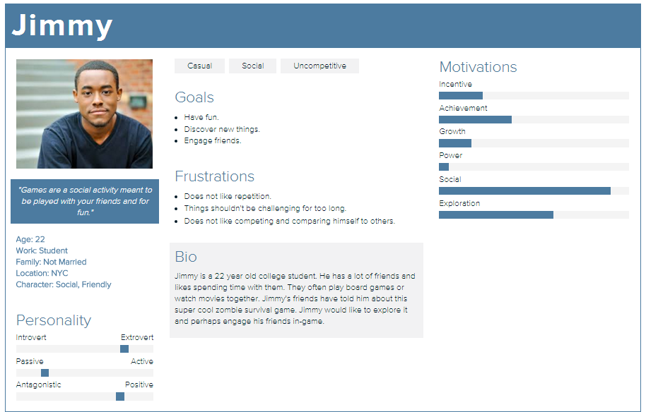

Slide 5
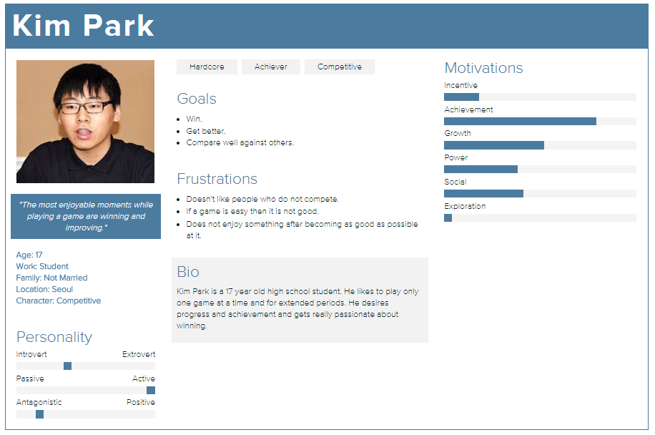
Personas

Slide 6
Requirements
Initiate Games that user play will and run them via a Python engine.
Display Street
Display day
Display player state: ammo, supplies, people in party, zombies killed and move points.
Display actions availed for play depending on where they are: street, house, room (normal), room (zombie infestation)
Player starts with a party of 1 and some supplies and ammo
Player can enter a house, or wait on the street. Entering the house costs movement points.
If player enters a house they can then search 1 of a variable number of rooms. In the room they can find supplies, ammo and people and possibly zombies. They can continue to search room or leave the house.
If the player encounters zombies the can: fight, wait or run.
If fight game engine determines outcome of fight based on number of people in party, number of zombies, and amount of ammo.
If number of number of party becomes zero, end game.
If run, player leaves.
Determine if people leave depending on supplies and number of people.
Determine if player dies at end of day.

Slide 7
Requirements
Maintain and update Profile(s)
Display profile picture
Show games played
Show handle
Show average, best day(s)
Show zombies killed, average, highest number killed in a game, *number of zombies killed in all games.
Show Achievements
Change player information

Slide 8
Requirements
Achievements (badges) will be in 4 categories and further broken down into additional ranking levels: Bronze, Silver, and Gold.
*When a User gets an achievement, offer the ability to notify via Facebook/Twitter
Killer number of zombies killed.
This is in 3 levels: 10, 20, 50
Stamina how many games played.
This is in 3 levels: 5, 10s, 20
Party number of people in a party.
This is in 3 levels: 5, 10, 20
Survivalist number of days survived.
This is in 3 levels: 5, 10, 20

Slide 9
Requirements
Maintain and display a Leaderboard
Show top 20 Users by days survived
Show top 20 Users by number of zombies killed
Users
Guest
Read instructions
View Leaderboard
*Search for a user
Register as user. *Can use site settings or register via Facebook/Twitter
Registered User
Login
*Via site or Facebook/Twitter
Logout
Read instructions
View leaderboard
*Search user
View and change their profile
Start New Game, Save, Resume
* Marks team added features.

Slide 10
High-level System Architecture

Slide 11
ER Diagram

Slide 12
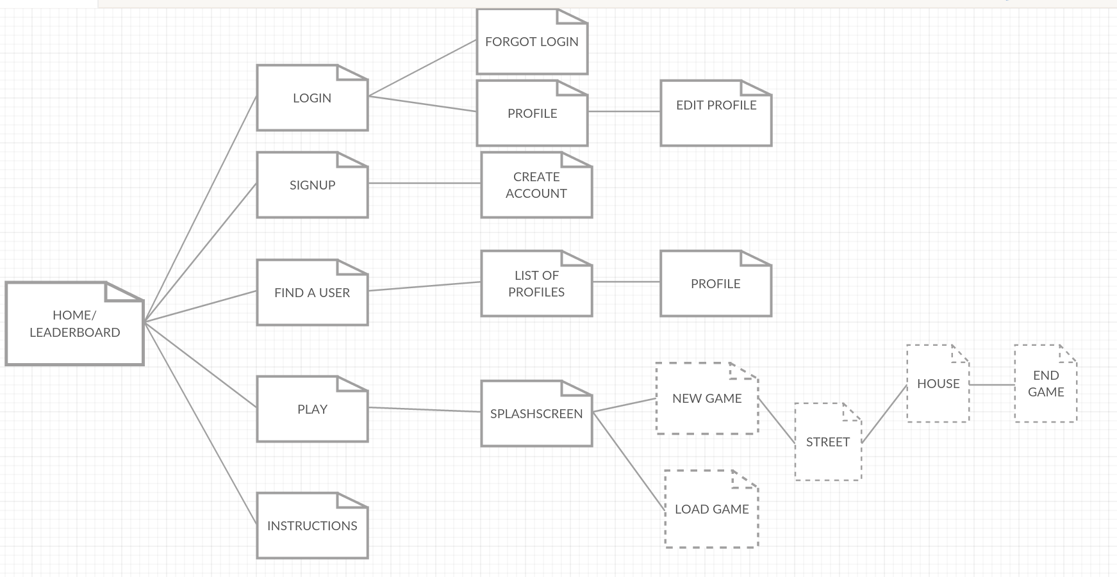
SITEMAP

Slide 13
URL DESIGN
https:\\www.zombiesearch.com
https:\\www.zombiesearch.com\about
https:\\www.zombiesearch.com\login
https:\\www.zombiesearch.com\newuser
https:\\www.zombiesearch.com\users\<username>
https:\\www.zombiesearch.com\<username>\edit
https:\\www.zombiesearch.com\game
https:\\www.zombiesearch.com\users\?u=<username>

Slide 14
WireFrame- initial design ideas

Slide 15
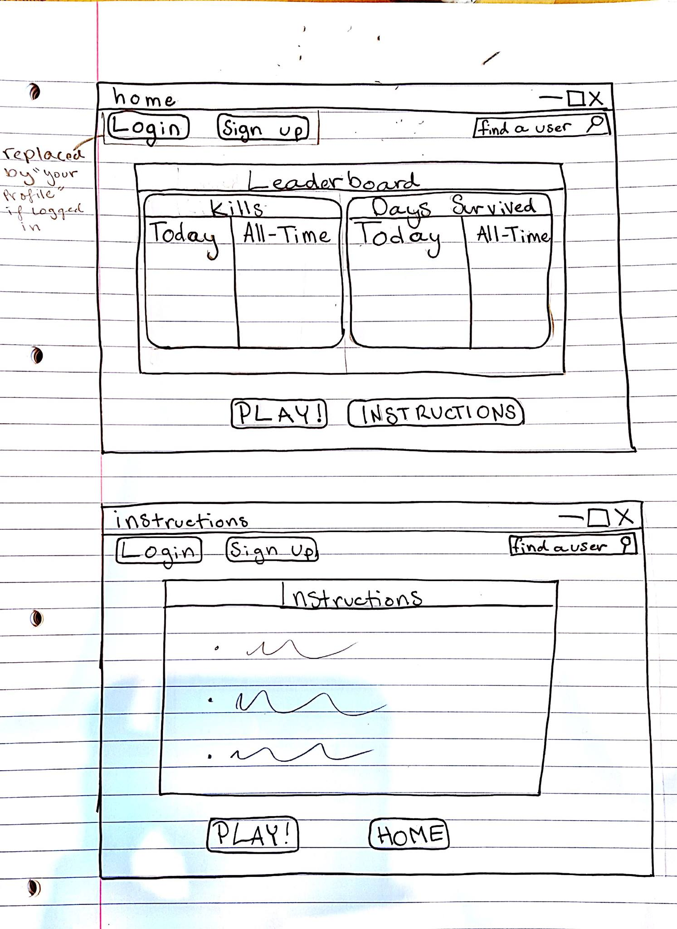

Slide 16
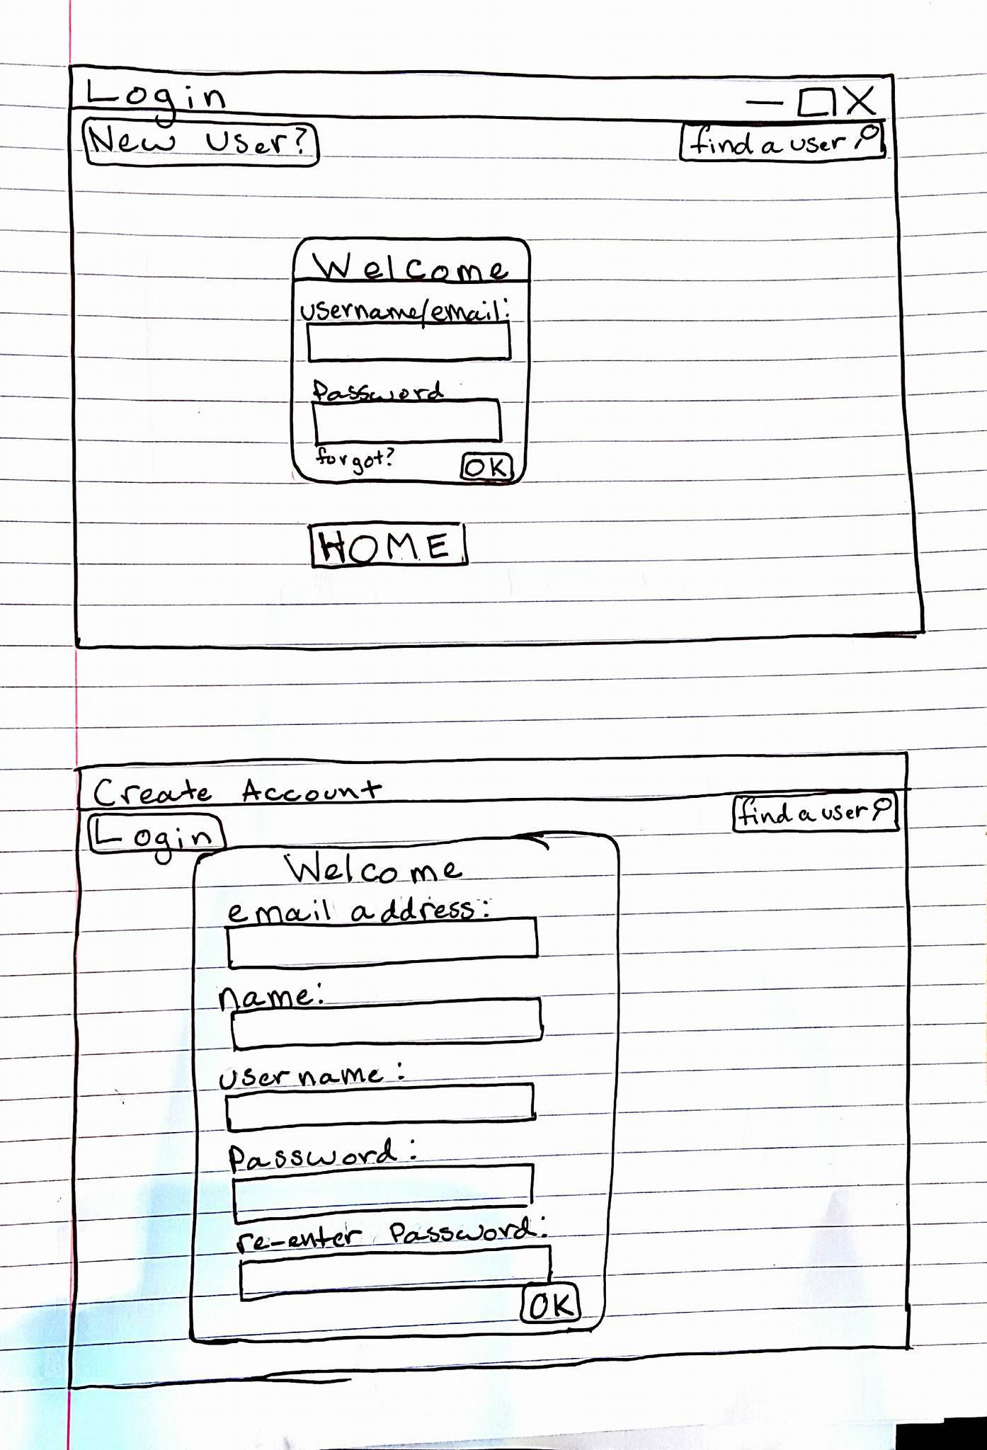

Slide 17
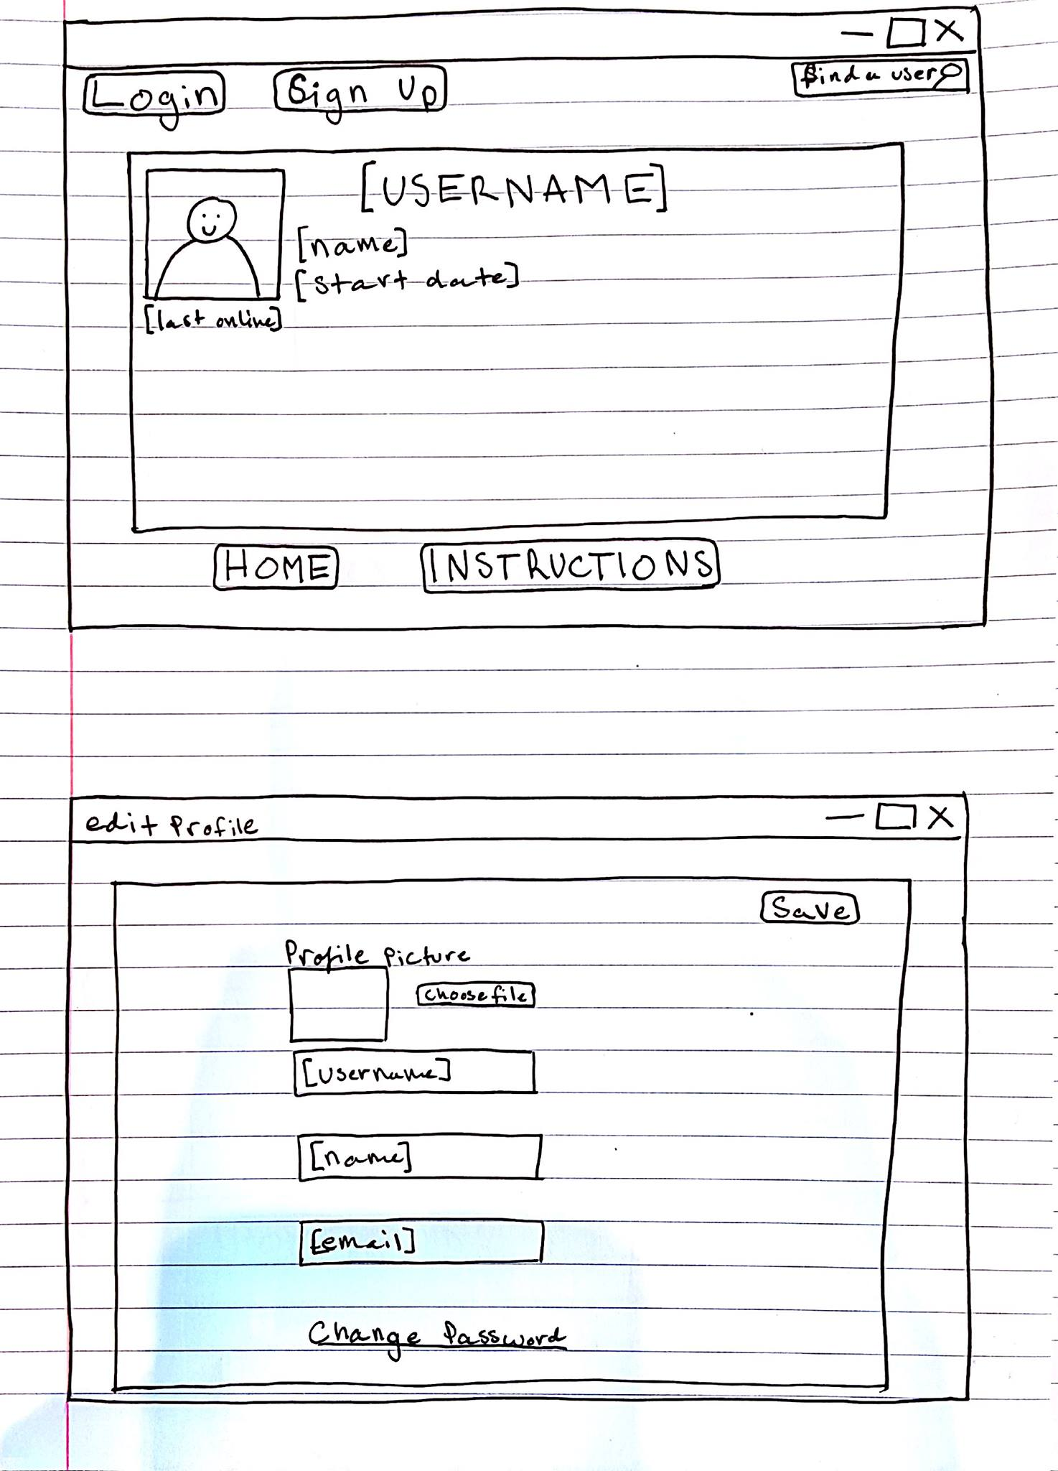

Slide 18
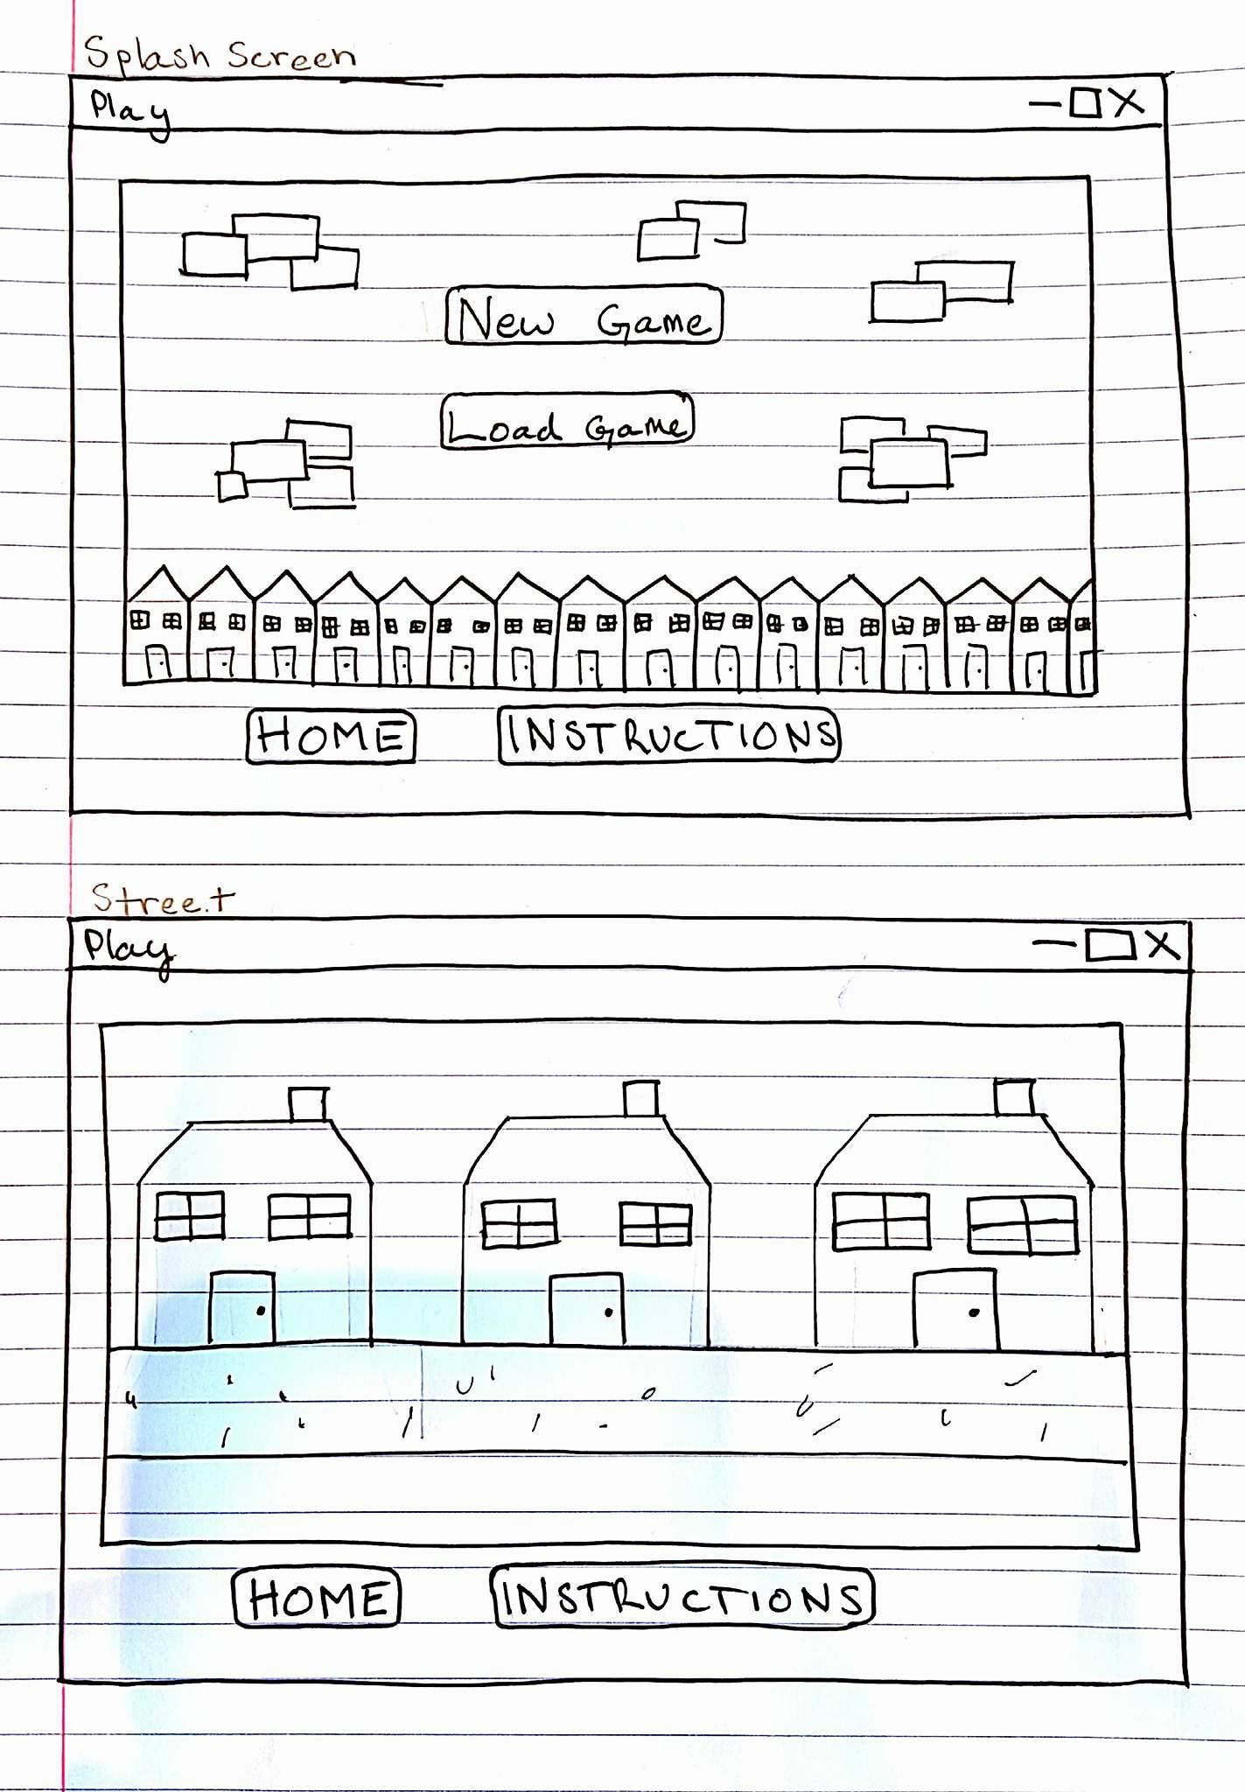

Slide 19
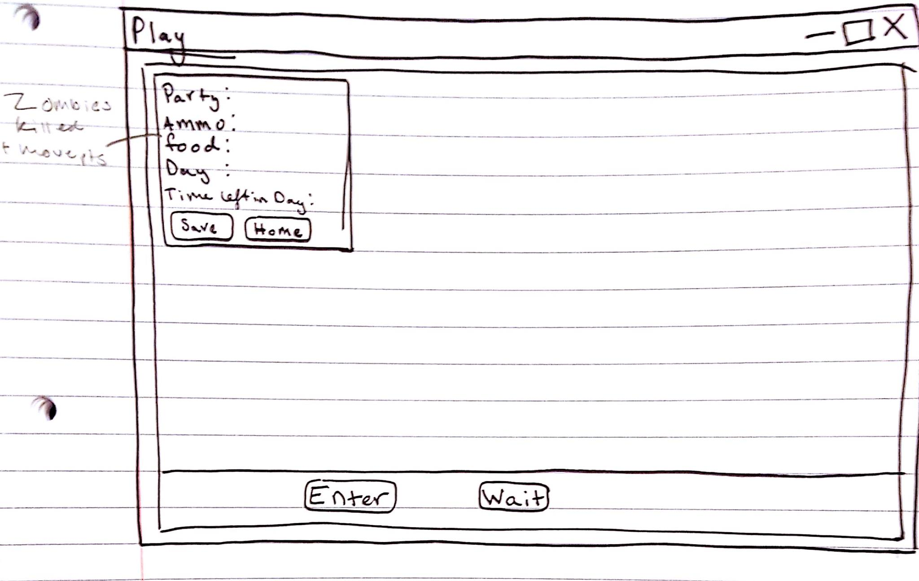

Slide 20
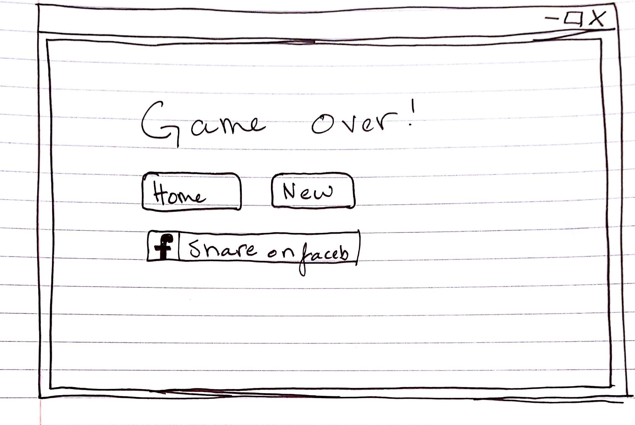

Slide 21
WireFrame- First Mockup

Slide 27
